Slide 1
Week 5 & 6
In His Name, the Most High
Sentence generation via word substitution & Dropping some classes
and
NN based approaches to perform intent detection and slot filling tasks

Slide 2
Sentence generation via word substitution
01. Cities
02. States

Slide 3
Sentence generation via word substitution
03. Airlines
04. days, months, …

Slide 4
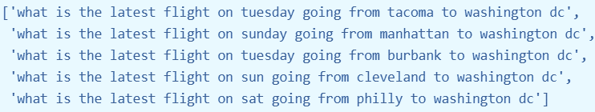
Some examples
01. Word embeddings
04. Similarity score & threshold
BoW, Word2Vec, GloVe, FastText, Transformer,...
Jaccard, WMD, Euclidean, Cosine, …
threshold → similar pairs
02. Sentence embeddings
05. End Notes
Doc2Vec, Sent2Vec, SentenceTransformer
🗸 Transformer based → SentenceTransformer → stsb-mpnet-base-v2 → Cosine similarity
may i please see airlines and flight numbers from new york to toronto on the same date june seventeenth also arriving in toronto before noon thank you
03. Pretrained models
stsb-mpnet-base-v2, stsb-roberta-base-v2, stsb-bert-large, …
january i please see airlines and flight numbers from san antonio to nashville on the same date february seventeenth also arriving in nashville before afternoon thank you

Slide 5
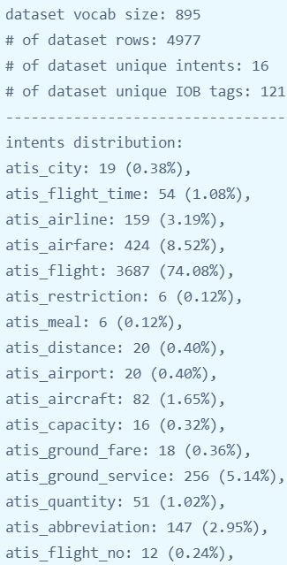
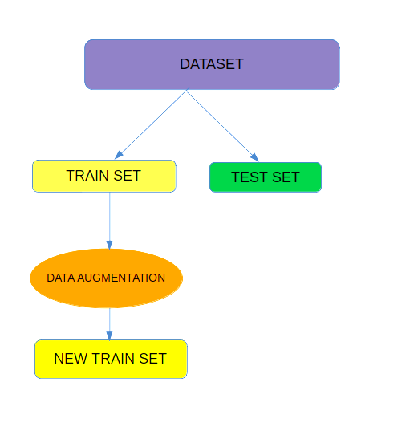
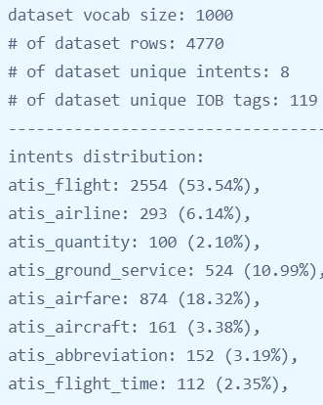
Dropping some classes…

Slide 6
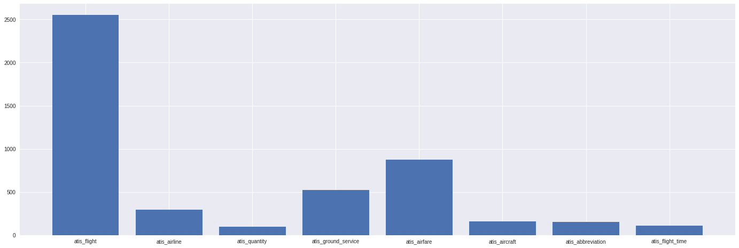
Final result after sentence generation & Dropping some classes

Slide 7
RNN based approaches to perform intent detection and slot filling tasks
feed-forward model by taking the average of all words’ vectors in an utterance as its input.
recurrent neural network which can take each word in an utterance as a vector one by one.
CNN, attention-based CNN, …
04. Similarity score & threshold
Deep neural network for intent detection
BoW, Word2Vec, GloVe, FastText, Transformer,...
Jaccard, WMD, Euclidean, Cosine, …
threshold → similar pairs
02. Sentence embeddings
05. End Notes
LSTM, slot-gated attention-based model, …
Doc2Vec, Sent2Vec, SentenceTransformer
🗸 Transformer based → SentenceTransformer → stsb-mpnet-base-v2 → Cosine similarity
Recurrent Neural network for slot filling
only recurrent neural network model is a feasible approach for this scenario.
03. Pretrained models

Slide 8
Recurrent Neural network for slot filling and Joint models
using the convolutional neural network (CNN) together with a conditional random field (CRF).
using single RNN model generating multiple semantic tags sequentially by reading in each word.
using an encoder-decoder model containing two RNN models as an encoder for input and a decoder for output.
Joint model for two tasks
Other methods.
using one encoder with two decoders, the first decoder will generate sequential semantic tags and the second decoder generates the intent.
consolidating the hidden states information from an RNN slot filling model, then generates its intent using an attention model.

Slide 9
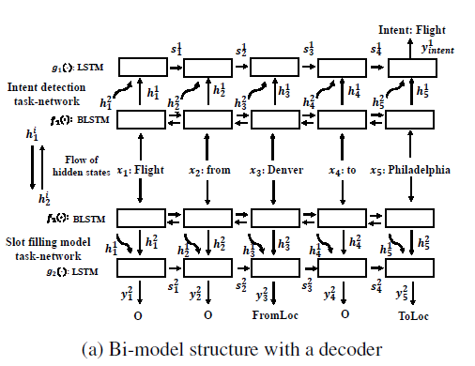
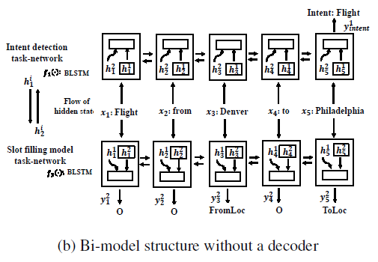
Bi-model based RNN for Joint Intent Classification and Slot Filling

Slide 10
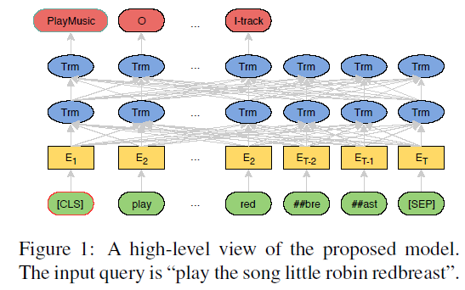
BERT for Joint Intent Classification and Slot Filling

Slide 11
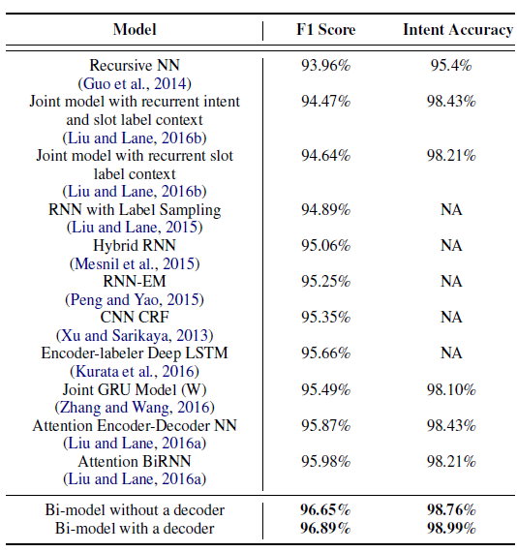
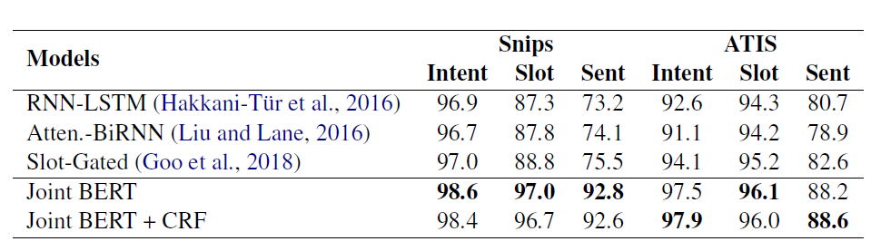
Comparison

Slide 12

weird bug in slot filling
The problem: an extra ‘O’ tag in test dataset!

Slide 13
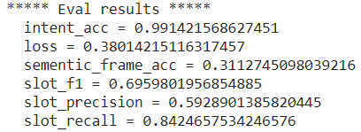

Results on our pre-processed data
Bi-model based RNN
BERT based model

Slide 14
Thanks
References:
Yu Wang, Yilin Shen, Hongxia Jin: “A Bi-model based RNN Semantic Frame Parsing Model for Intent Detection and Slot Filling”, 2018; arXiv:1812.10235.
Qian Chen, Zhu Zhuo, Wen Wang: “BERT for Joint Intent Classification and Slot Filling”, 2019; arXiv:1902.10909.

